Slide 1
LEADING UNIVERSITY
… A Promise To Lead
Orientation Program
TITLE SLIDE GOES HERE
44th Batch
Optional subhead would go here
Department Of Computer Science & Engineering

Slide 2
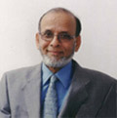
Founder
Danobir Dr. Syed Ragib Ali
Chairman
Leading University, Sylhet

Slide 3
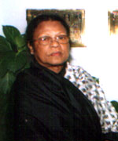
Co-Founder
Late Begum Rabeya Khatun Chowdhury
Co-Founder
Leading University, Sylhet

Slide 4
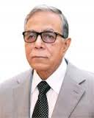
Chancellor
Md. Abdul Hamid
Hon’ble President
People’s Republic of Bangladesh

Slide 5
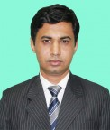
Vice Chancellor
Professor Dr. Md. Qumruzzaman Chowdhury
Vice Chancellor
Leading University, Sylhet

Slide 6
Dean
Professor Dr. Khandoker Mohammad Mominul Haque Chowdhury
Dean,
Faculty of Modern Science
Leading University, Sylhet

Slide 7
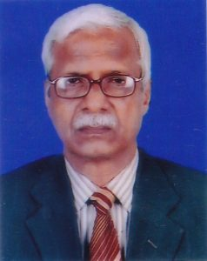
Dean
Professor Md. Nazrul Islam
Dean,
Faculty of Business Administration
Leading University, Sylhet

Slide 8
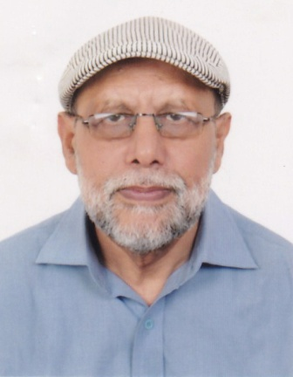
Dean
Professor Dr. S. M. Ali Akkas
Dean,
Faculty of Social Science
Leading University, Sylhet

Slide 9
Registrar
Professor Dr. S. M. Ali Akkas
Dean,
Ragistrar
Leading University, Sylhet

Slide 10
Accounts Department
Functions related to Student:
Location: 5th Floor , Rongmohol Tower Campus.
Service:
Semester Payment Slip
Due Payment Slip
Makeup/Improvement Payment Slip
Payment Related Query

Slide 11
Exam Office
Functions related to Student:
Location: 5th Floor , Rongmohol Tower Campus.
Service :
Admit Card
Makeup/ Improve Application Form
Studentship/Transcript/Certificates Application Form

Slide 12
Faculty Member of CSE
Dr. Refat Kibria
Associate Professor
Rumel M. S. Rahman Pir
Assistant Professor
Md. Asaduzzaman Khan
Assistant Professor Head ( Acting ), Assistant Proctor, LU
Minhazul Haque Bhuiyan
Senior Lecturer Convener, Project/Thesis Committee Assistant Proctor

Slide 13
Faculty Member of CSE
Selina Sharmin
Senior Lecturer
Alak Kanti Sarma
Senior Lecturer , Member, Routine Committee
Arafat Habib Quraishi
Senior Lecturer, Member, Routine Committee
Md. Ebrahim Hossain
Lecturer
Md. Saiful Ambia Chowdhury
Lecturer , Coach, Programming Contest Teams
Iffat Jahan Choudhury
Lecturer

Slide 14
Faculty Member of CSE
Faculties on Study Leave:
Arif Ahmad
Assistant Professor (on PhD SUST)
Rana M Luthfur Rahman Pir
Lecturer (Australia)
Md. Shohidur Rahman
Senior Lecturer (Finland)
Sheikh Mustaq Ahmmed
Lecturer (Germany)
Mostafa Wasiuddin Numan
Lecturer (Australia)

Slide 15
Course Distribution

Slide 16
Exam system & Mark Distribution Policy
Examination is Divided in three main parts:
Student Activity(30 Marks)
Tutorial ------- 10 Marks
Attendance -- 05 Marks
Presentation - 05 Marks
Assignment -- 05 Marks
Viva ------------ 05 Marks
Mid Term Examination(30 Marks) – 1.5 Hour
Final Term Examination (40 Marks) – 2.0 Hour

Slide 17
Drop/Retake Course
Drop Course:
If anyone did not pass the prerequisite for a particular course, they will not be able to enroll that course. This becomes a drop course.
Retake Course:
If anyone fails (total marks below 40)in a course they have to enroll that course as retake within two consecutive semesters.
Improvement:
If anyone need to improve (marks below 60) he/she have to take the course in the immediate next semester.

Slide 18
Makeup Exam Policy
Makeup:
Student can sit for makeup exam(mid term & Final exam) if he/she can submit proper evidence of medical ground or unavoidable circumstances.
***Make up of Tutorial/Assignment/Presentation/Viva is not allowed.

Slide 19
Tuition Fees
Payment method of Tuition Fees in each semester:
Every students have to pay the full tuition fees in the beginning of the semester within the time duration given by the authority.
If anyone fails to pay on time must take prior permission in written. In that case students have to made partial payment.

Slide 20
Achievements of CSE Dept.
ACM ICPC-2016 Asia Dhaka Regional:
Team LU_Lethargic & team LU_Serious ranked 15th and 16th place among all universities(70) in Bangladesh & best among private universities in Sylhet.
Achievement in NCPC-2016:
LU_lEthArgic attained 15th position among 119 teams from all over the country.
Among all public & private university, Leading University’s position is 7th and among private universities, Leading University is now the 2nd best in the country.

Slide 21
Student Advisors
***For any kind of academic help each batch/section is supervised by an advisor.
Advisor List of 44th Batch
Section A – Md. Asaduzzaman Khan
Section B – Rumel M S Rahman Pir
Section C – Minhazul Haque Bhuiyan
Section D – Selina Sharmin
Section E – Alak Kanti Sarma

Slide 22
Code of Conduct for Students
Disciplinary actions will be taken for the following offence committed by any student(s)
Academic Dishonesty and Plagiarism
Sexual Harassment
Narcotic Offence
Misconduct with Faculty Members and University Officials
Disruption
Violence
Damage to Property
Physical Abuse
Unlawful Confinement
Disorder
Undesirable Behavior
Fraud

Slide 23
University Clubs
Leading University Computer Club
Leading University Social Service Club
Leading University Electronics Club
Leading University Cultural Club
Leading University Debating Club
Leading University Model United Nation
Leading University BNCC
Leading University Sports Club
Leading University Photographic Society
Musical Band: ORPHEUS & BANNED COMMUNITY

Slide 24
Useful links
Portal Registration: http://www.lus.ac.bd/student-registration/
Semester Registration: http://www.lus.ac.bd/semester-registration/
Class Routine: http://www.lus.ac.bd/class-routine/
Department Page: http://www.lus.ac.bd/academic/department-of-cse/

Slide 25
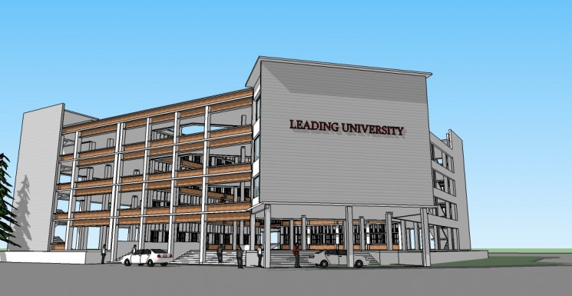
Thank You

